Slide 1
Map production
Objectives: | Understanding of map production for spatial data
Keywords: | Map production, map layout, scale bar, north arrow, legend, map body, map unit

Slide 2
Cartography
The science and art of map making techniques together with their study.
Types of cartography:
Maps
Plans
Charts
Three dimensional models
Globes

Slide 3
Map production
is the process of arranging map elements on a sheet of paper in a way that, even without many words, the average person can understand what it is all about.
Maps are usually produced for presentations and reports where the audience or reader is a politician, citizen or a learner with no professional background in GIS.
Because of this, a map has to be effective in communicating spatial information.
The science and art of map making techniques together with their study is known as Cartography

Slide 4
A representation of a small or a large area of the earth on a flat piece of paper.
Common elements of a map are the
Title
Map body,
North arrow
Projection
Scale Bar
Legend
Source statement (Acknowledgment)
Map border

Slide 5
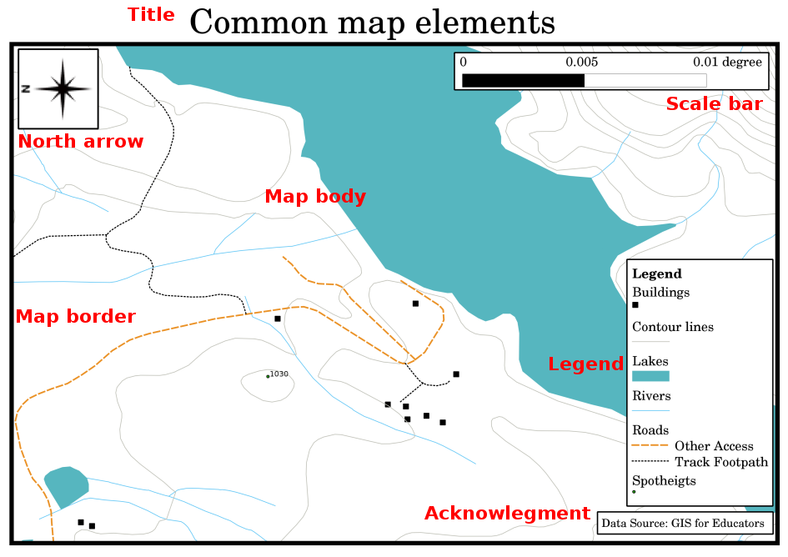

Slide 6
Scale
Ratio between map distance and ground distance is termed as map scale
Expression of Scale
Statement of Scale
Representative Fraction
Linear Scale

Slide 7
Units of measurement
Non-Metric Units
12 inches = 1 Foot
3 Feet = 1 Yard
220 Yards = 1 Furlong
1760 Furlongs = 1 Mile
63360 Inches = 1 Mile
Metric Units
100 cms = 1 Meter
1000 Meters = 1 Km
100,000 cms = 1 km

Slide 8
Expression of Scale
Statement of Scale
3 Inches = 1 Mile
1 cm = 1 Km
Representative Fraction
R.F = Map Distance/ Ground Distance 1/63360

Slide 9
Expression of Scale
1 inch = 4 miles
1 mile = 63360 inches
4 miles= 63360 * 4 = 253440 inches
R.F. = 1 / 253440
1/250,000 (miles)
63360 inches = 1 mile
250,000 inches = 250,000/63360 = 3.95 miles 1 inch = 3.95 miles

Slide 10

Expression of Scale
Linear Scale
1 inch = 100 miles 1/6336000
Express 1 / 1,000,000 by a plain scale to show kilometers

Slide 11
Classes of Maps
Scale
Communication objectives
Subject matter and function

Slide 12
Scale
Small scale map
represents larger area on a small map area with less details, e.g., World maps.
Small scale map ( 1: 500,000)
Large scale map
represents smaller area, with detail data represented on a relatively large map area,e.g., Topographic maps
Large scale map (1:50,000)

Slide 13
Communicative Objectives
General reference maps show the location of variety of different features. They supply a general image of the earth surface and are also termed as base maps.
Thematic maps represent distribution of one particular attribute or the relationship among several and instead of focusing on representation of location these maps mainly focus on illustrating structures.
Thematic maps tended to be of small scale.

Slide 14
Subject Matter and Functions
Cadastral maps
Topographical maps
Soil maps
Weather maps
Population maps
Political maps

Slide 15
Common problems / things to be aware of
It is sometimes difficult to create a map that is easy to understand and well laid out whilst still showing and explaining all the information that the reader needs to know.
To achieve this,
you need to create an ideal arrangement and composition of all the map elements.
You should concentrate on what story you want to tell with your map and how the elements, such as the legend, scale bar and acknowledgements should be ordered.
By doing this, you will have a well designed and educational map, that people would like to look at and be able to understand.

Slide 16
What have we learned?
Let’s wrap up what we covered in this worksheet:
Map production means arranging map elements on a sheet of paper.
Map elements are the title, map body, map border, legend, scale, north arrow and the acknowledgement.
Scale represents the ratio of a distance on the map to the actual distance in the real world.
Scale is displayed in map units (meters, feet or degrees)
A legend explains all the symbols on a map.
A map should explain complex information as simply as possible.
Maps are usually always displayed ‘North up’.

Slide 17
Now you try!
Here are some ideas for you to try with your learners:
Load some vector layers in your GIS for your local area. See if you can identify examples of different types of legend elements such as road types or buildings.
Create a list of legend elements and define what the icons should look like, so a reader can most easily figure out their meaning in the map.
Create a map layout with your learners on a sheet of paper.
Decide on the title of the map, what GIS layers you want to show and what colors and icons to have on the map.
Use the techniques you learned in Topics Vector Data and Vector Attribute Data to adjust the symbology accordingly.
When you have a template, open the QGIS print layout and try to arrange a map layout as planned.

Slide 18
Something to think about
If you don’t have a computer available, you can use any topographical map and discuss the map design with your Fellows.
Figure out if they understand
what the map wants to tell.
What can be improved?
How accurately does the map represent the history of the area?
How would a map from 100 years ago differ from the same map today?

Slide 19
Further reading
Books:
Chang, Kang-Tsung (2006). Introduction to Geographic Information Systems. 3rd Edition. McGraw Hill. ISBN: 0070658986
DeMers, Michael N. (2005). Fundamentals of Geographic Information Systems. 3rd Edition. Wiley. ISBN: 9814126195
Website: Scale (map)
The QGIS User Guide also has more detailed information on map production provided in QGIS.

